Slide 1
Back to School 2022
Information current as at 23 January 2022
Developed in partnership with NSW Health
Notes:
Return to school intro slide
ACTION: Insert your school logo in the box to personalise the slideshow.

Slide 2
Acknowledgement of Country
I acknowledge that I am hosting this virtual assembly from the lands of the Darug People. I also acknowledge the Ongoing Custodians of the various lands on which you are all calling in from today and the Aboriginal and Torres Strait Islander people participating in this assembly and throughout our school community.
Notes:
Acknowledgment of Country
ACTION: Insert name of the traditional custodians of the lands in which your school/community is located in the text on the slide.

Slide 3
What we'll cover in this session
- Before term 1 begins
- COVID-smart measures for our school
- Testing
- What to do when COVID-19 positive?
- Vaccinations
- Ventilation
- Masks
- Visitors and activities
- Minimising the spread
Digital learning packages
- Learning from home
- Further information and questions
Notes:
Return to school in 2022
Note: This is an introductory slide for you to welcome the community and give an overview of the contents of this virtual assembly.
Note: on many of the slides in this virtual assembly PPT you will see generic text relevant to all schools followed by red text in brackets for you to include tailored information relevant to your school community. For example, you will see red text reminding you to delete sections if not applicable to your school and to adapt the content as you see appropriate.

Slide 4
What you need to know about our return to school in 2022
Our COVID-smart measures have been developed with NSW Health to minimise transmission and keep schools open in 2022.
We’re taking every precaution to safeguard our learners and school communities, building on our experiences of the last 2 years.
Back to School is an exciting time, particularly for students starting school for the first time. A layered approach which prioritises safety will help keep schools open, where we know the best learning happens.
Our guidance is evidence-based and will provide additional levels of protection in a way that works for schools.
[
Notes:
What you need to know about our return to school in 2022
Talking points: The department’s COVID-smart return to school plan is approved by NSW Health and includes layers of protection to support the health and wellbeing of our students and staff. These practices include RAT testing, vaccinations, mask wearing, reduced mingling of student groups and staff, enhanced ventilation in classrooms and continued good hygiene and cleaning.

Slide 5
What you need to know about our return to school in 2022
This is not a normal start to the year – however, we know that being together in the classroom is the most effective way for students to learn and grow.
Your child's relationship with their teacher is important, but as we manage any potential disruptions to staffing due to COVID-19, they may get to meet more teachers than normal.
Notes:
What you need to know about our return to school in 2022
Talking points: 2022 will be a back to school period like no other – but we're committed to helping keep our classrooms open in a safe way that keeps students learning and growing.
This may mean your child meets more teachers than usual this year, as we manage any potential staffing disruptions due to COVID.

Slide 6
Before Term 1 begins
Rapid antigen tests (RATs) will be provided to all staff and students through our school.
Surveillance testing will provide an important additional layer of protection for our students and staff. Use of RAT kits is highly recommended but not mandatory.
Conduct your child's RATs at home on the morning of school, twice a week on school days and before term starts.
Participating students and staff are strongly encouraged to confirm a negative rapid antigen test before attending school at the start of Term 1.
If your child is a household close contact, you must follow NSW Health advice to stay home and isolate.
Notes:
Before term 1 begins
Rapid Antigen Tests (RATs) will be distributed to schools shortly – we want every student to have the opportunity to be tested before term 1 begins.
All participating students must return a negative RAT result before attending school at the start of term 1.

Slide 7
Testing
During the first 4 weeks of term, students and staff are encouraged to do a rapid antigen test (RAT) twice a week on school days in the morning before attending school.
RATs will be supplied by schools with staggered collection times for parents and carers to avoid congestion.
The RAT kits will include instructions for use, how to check the results and how to dispose safely.
Parents and carers can download an instruction sheet for the rapid antigen test through the Therapeutic Goods Administration (TGA) website.
NSW Health also has videos on how to use RATs, including translated materials.
Your child/childrens’s RAT Kits can be picked up from our school from 11am-4pm on Friday 28th. Please QR code into the school and wear a mask. Collection point will be under the Kindergarten COLA
Notes:
Testing
Students are encouraged to do a rapid antigen test twice a week during the first 4 weeks of term 1.
ACTION: Replace red text with any school-relevant information about support for testing.

Slide 8
Testing
All students and staff at schools in our Support Unit (SSPs) will be provided with a kit containing 10 days' worth of RATs to be used every school day for an initial 2-week period.
Notes:
Testing
ACTION: Remove slide if not a school for specific purpose (SSP)

Slide 9
Testing
If your child has even mild COVID-19 symptoms, get them tested with a RAT or PCR (nose and throat swab) test.
They must isolate until they receive a negative test result, in line with health protocols.
If symptoms continue, they should stay at home and take another RAT in 24 hours or have a PCR test. If the second RAT or initial PCR test result is negative or another diagnosis is confirmed such as hay fever, they can return to school.
Parents and carers must register positive RAT results from students on the Service NSW website or Service NSW app and notify the school as soon as possible.
Report positive PCR test results from students to the school as soon as possible.
Notes:
Testing
Even mild COVID-19 symptoms require a test – RAT or PCR.
Do not return to school until your child/guardian is symptom free.

Slide 10
What to do when COVID-19 positive?
Under the new close contact rules, schools are no longer included in contact tracing.
Positive RAT results must be registered on the service.nsw.gov.au website or Service NSW app. Only positive RAT results will need to be reported via the Service NSW website and app.
Students who receive a COVID-19 positive RAT or PCR test must tell their school as soon as possible and isolate for 7 days.
Your principal will inform the school community when there is a positive case at school and advise families on public health advice, including monitoring for symptoms.
Follow the latest Health advice for guidance on how to manage and treat COVID-19, including when to leave isolation and return to school.
Notes:
COVID-19 positive results
Parents/carers must inform their school as soon as possible if a student receives a positive RAT or PCR result.
Principals will inform the school community and advise families on public health advice.

Slide 11
Vaccinations
All staff on school sites must be fully vaccinated, including having their booster when eligible.
We strongly recommend all eligible students (and their families) who are 5 years and older get vaccinated.
COVID-19 vaccination is the best protection against severe illness and also reduces the risk of spreading it to others.
Visit the Find a vaccine clinic website to book an appointment near you.
Notes:
Vaccinations
ACTION: Replace red text with school-relevant information about vaccinations, We are encouraging our school community to take up a vaccine as soon as possible xx, vaccines are available for eligible students and we encourage them to get vaccinated before returning to school, etc.

Slide 12
Ventilation
Natural ventilation is the most effective measure, so we will maximise fresh air flow in learning spaces through opening doors and windows. This approach is strongly supported by expert advice.
Where natural ventilation is not sufficient, mechanical ventilation and/or air purification will be used and we will continue to use outdoor settings where possible.
Air purifiers have been provided to schools as a supplementary measure to support common areas in schools and can be deployed at the principal's discretion.
We’ll continue to encourage using outdoor spaces.
Notes:
Ventilation
Please refer to the department’s information on ventilation for more information if required.

Slide 13
Masks
All primary and secondary school staff will be required to wear surgical masks indoors.
All staff and visitors must wear surgical masks indoors on school site.
All students are strongly recommended to wear well-fitted masks indoors. Surgical masks are strongly encouraged.
A teacher may offer your child a mask.
We will include surgical masks with your RAT Kit should you wish for your child to use them.
Notes:
Masks
ACTION: Adjust for primary or high school setting (remove red text).

Slide 14
Masks
No vented or cloth masks should be worn.
Surgical masks will be provided by the school if required.
We will be distributing surgical masks with the RAT Kits and they will also be available in classrooms should students wish to wear them.
Notes:
Masks
ACTION: Insert school-specific details on how masks will be distributed.

Slide 15
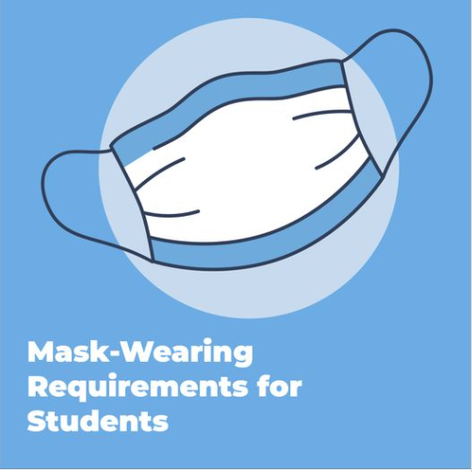
Mask wearing for students
Surgical masks are strongly encouraged in outdoor settings where you cannot physically distance.
Your child can remove their mask when eating, exercising and playing a musical instrument.
For more information, refer to Masks and face coverings.
Notes:
Masks
Surgical masks are strongly encouraged in outdoor settings where you cannot physically distance.
You can remove your masks when eating, exercising and playing a musical instrument.
For more information, refer to Masks and face coverings.

Slide 16
Fitting a mask on a younger child
Please send your child with a mask and a spare in their bag. We'll have some on site too.
The following graphic from NSW Health shows how to fit a mask properly – please have this conversation with your child.
While masks are not required in the Public Health Order for our primary students, they are strongly recommended by NSW Health. The department has taken the decision that they are required as an important layer of protection for our staff – particularly around younger students who are yet to be vaccinated.
There are some exemptions around mask wearing – such as when eating and exercising. Please review the NSW Government website for the full list of exemptions. nsw.gov.au/covid-19/rules/changes/face-mask-rules
Notes:
Fitting a mask to younger children
Note: Remove this page if not relevant to your school setting.

Slide 17
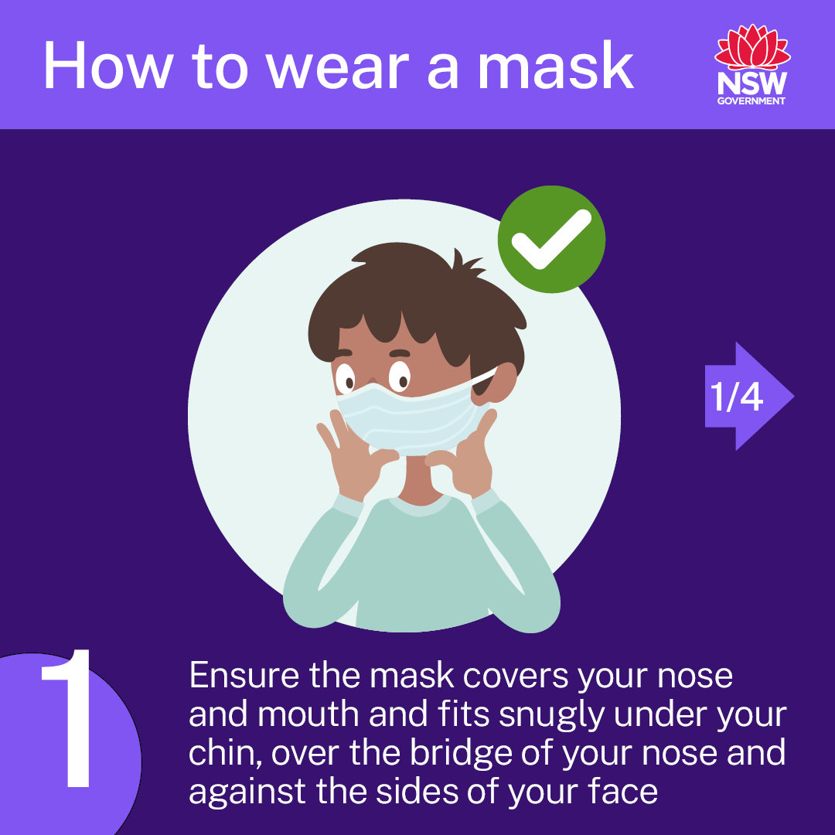
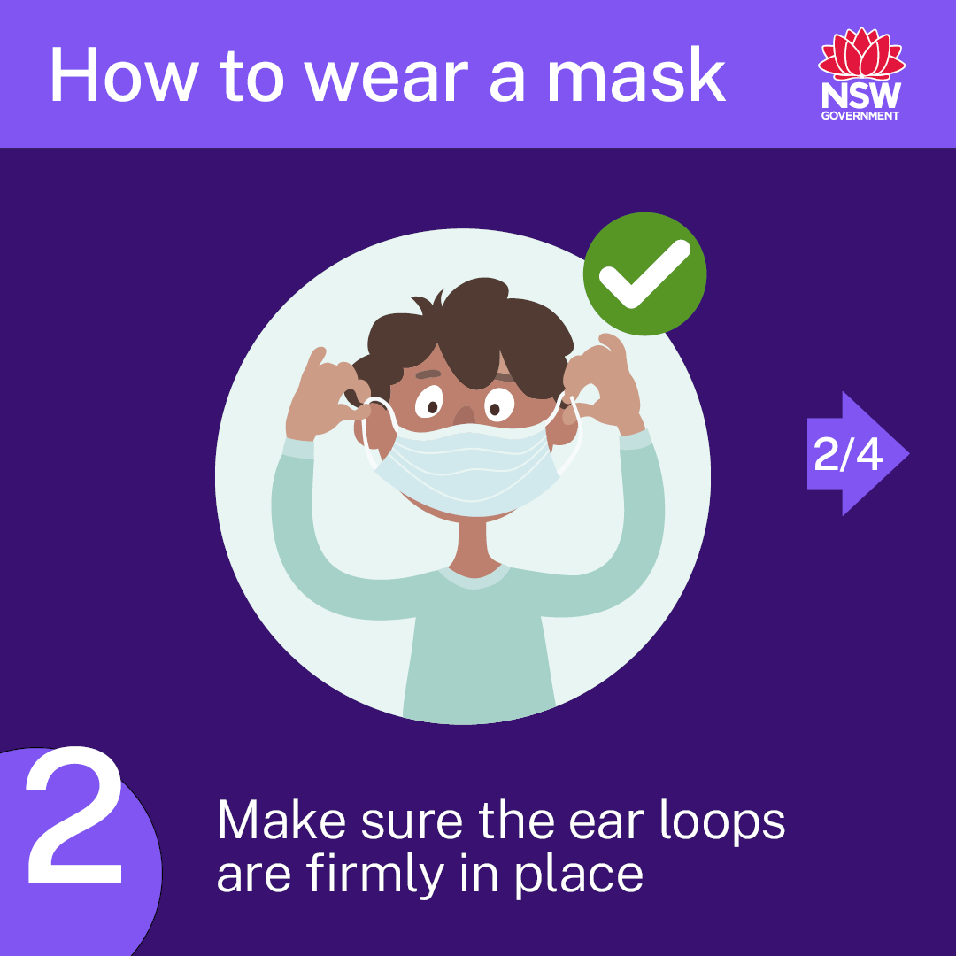
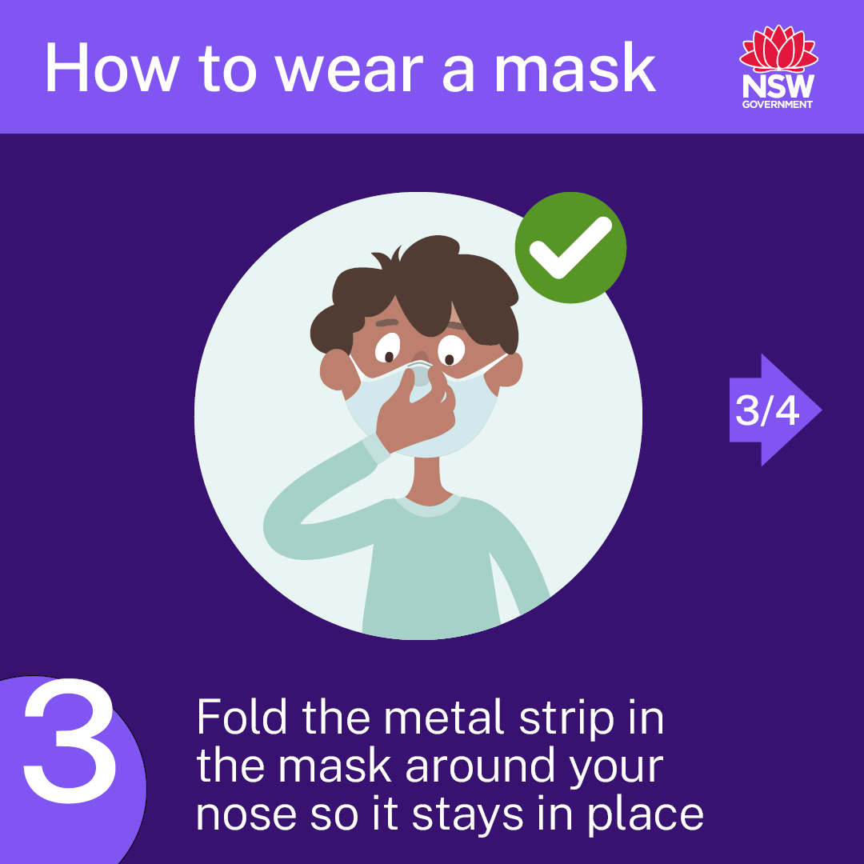
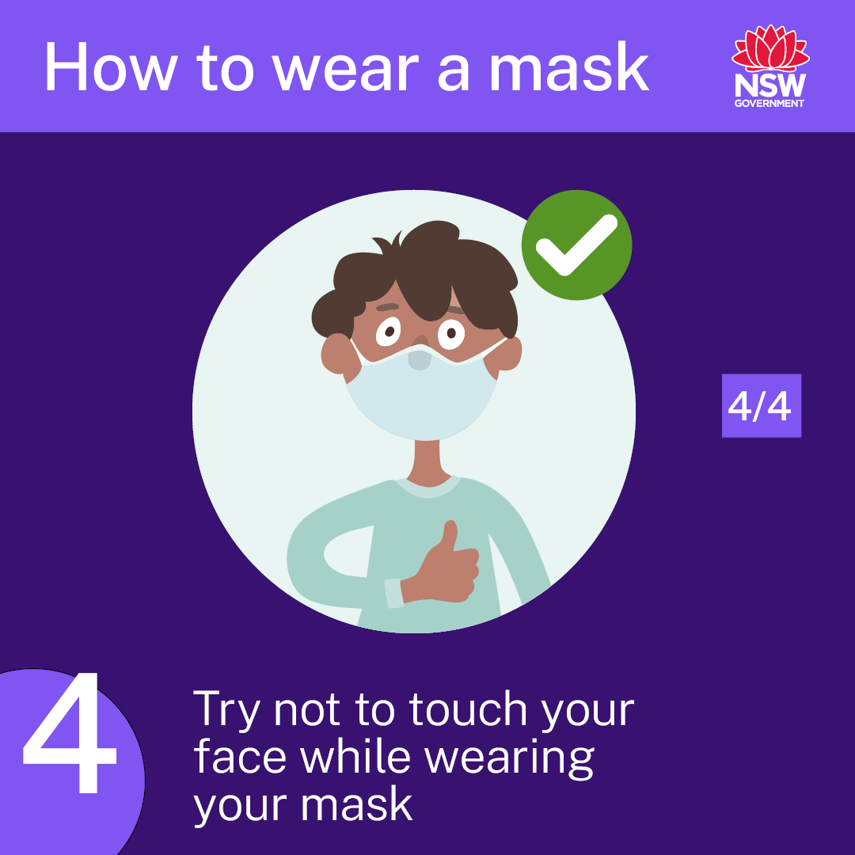
Fitting a mask to younger children
Notes:
This graphic has been provided by NSW Health. In the principal's toolkit are a range of posters, social media posts and resources you can use to support mask wearing on site and with your school communities.

Slide 18
Visitors and activities
Until further notice, no visitors will be allowed on school grounds except two parents or carers to support Kindergarten students or students starting at a new school.
No visitors are allowed on school sites until further notice except for fully vaccinated:
workers or volunteers operating uniform shops and canteens
visitors supporting school operations and curriculum delivery
allied health partners for student wellbeing purposes.
At this stage our canteen will not be operational for the first four weeks. We will keep you posted as to when it will become operational.
Notes:
Visitors and activities
ACTION: Remove red section if not relevant to your school setting (primary/secondary).

Slide 19
Visitors and activities (continued)
The department has provided guidance to schools on assessing higher risk activities and applying appropriate safeguards.
We will seek parental consent for participation in any extracurricular, outside of school hours or off-site activities – with appropriate safeguards in place.
Sports and PDHPE activities like swimming carnivals may proceed provided COVID-19 guidelines are followed, such as:
being held in a well-ventilated outdoor area
reduced visitors
non-contact adaptations (including avoiding high-fives/handshakes)
maintaining student cohorts.
Notes:
Visitors and activities
COVID-smart guidelines for school activities have been provided by the department. We will seek parental consent for participation in any extracurricular, outside of school hours or off-site activities – with appropriate safeguards in place.

Slide 20
Minimising the spread
We will aim to minimise opportunities for COVID-19 to spread by reducing interaction between students.
Students and staff experiencing even the mildest COVID-like symptoms must stay at home (even if they have a negative rapid antigen test).
Students will be kept in their year groups on school grounds, with staggered drop-off and pick-ups, break times, playground and canteen access.
Notes:
Minimising the spread
Important reminder: Even mild COVID-like symptoms mean students and staff must stay home, even with a negative RAT result.

Slide 21
Minimising the spread (continued)
We will implement the same cohorting measures as we did in Term 4 2021. Students will enter the school grounds via the front and back gate in the morning and will go directly to their allocated area.
Afternoons will be staggered. We will SMS you the procedure once we have it finalized.
We will continue to use best practice hygiene processes on school site.
Our enhanced cleaning practices will focus on 'high-touch' areas that students and staff move through regularly.
We will continue to highlight physical distancing, maintaining 1.5 metres distance wherever possible.
All staff and essential visitors will continue to use the school’s QR code check-in.
Notes:
Minimising the spread
ACTION: Replace red text with school-relevant information about managing cohorting. Examples might include staggered recess and lunch breaks, staggered start and finish times. Draw from your reflection tool.

Slide 22
Digital learning packages
If face-to-face learning is not possible, our school will be supported to start home learning through digital learning packages for short periods.
Online learning and lessons have been developed by the department and will be shared online.
Schools will have ongoing support for learning from home activities if required, and we will let you know when we can return to face-to-face learning.
Each stage will communicate to parents through either Google Classroom or See Saw app.
Whole school SMSs will be sent out when needed.
Notes:
Learning from home
ACTION: Replace red text with school-specific information.

Slide 23
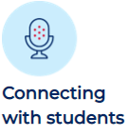
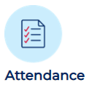
Learning from home
The following minimum expectations for delivering remote learning will help reduce disruptions for students:
Existing program/lessons to be adapted into an online format in a student-centred way.
Daily check-ins with all students from our Check in Team.
Updated training for delivering learning online to be provided to teachers on the school staff development day.
Schools to record and monitor attendance both online and offline.
Schools to ensure students have access to the internet and internet-enabled devices with Teams and Zoom.
Notes:
Learning from home
ACTION: Remove slide if required.
These minimum expectations for delivering remote learning aim to reduce disruptions to learning.
- Consider how these can be adapted into single units of work for both online/offline delivery
- Check-ins with all students using video conferencing should be planned daily
- Updated PL for delivering learning online and digitally will be provided on your school staff development day
- Schools are expected to use department-preferred online platforms and record/monitor attendance
- Schools to ensure students have access to internet-enabled devices with Teams and Zoom.

Slide 24
Preschool and outside of school hours care
Outside of school hours care, vacation care settings and preschools operating on school sites will follow the same COVID-smart guidelines as public schools including:
Twice weekly RAT testing for students and staff is encouraged
All staff are required to be fully vaccinated including having their booster when eligible.
Parents and carers are not to enter school grounds and are to follow Cubby Oosh’s procedures.
Notes:
Preschool and out of hours care
ACTION: Delete page if not relevant to your school setting. If relevant, replace red text with school-specific information.

Slide 25
Further information and questions
Where possible, we expect all of our students to be back at school for Day 1, Term 1.
Advice for families
Find updated information on the department's Advice for families page to support students who are anxious about returning to school – or get in touch with us directly. education.nsw.gov.au/covid-19/advice-for-families
Guidelines if your child is exposed to COVID-19
Visit the NSW Health website for the latest guidance if your child/guardian is a household close contact. health.nsw.gov.au/Infectious/factsheets/Pages/people-exposed-to-covid Managing COVID-19 at home Advice for managing COVID-19 at home, including when to leave isolation. health.nsw.gov.au/Infectious/factsheets/Pages/advice-for-confirmed
Notes:
[Insert school's COVID-safe measures to maintain student safety – reiterate hygiene practices and cleaning as well as the wellbeing and social benefits of students seeing their friends. Parents can refer to the wellbeing for students and families page https://education.nsw.gov.au/covid-19/wellbeing-for-students-and-families]

Slide 26
Thank you
There will be a Q and A Zoom Meeting on Monday 31st at 6: 30pm. The link will be on our school website and can be found in the COVID 2022 Information tab.
Mrs Kathy Browne
Principal
Notes:
Final thank you slide
ACTION: You may need to take questions on notice if you're unsure of the answer. Insert links to sources for further information (school website, Advice for families COVID-19 page (https://education.nsw.gov.au/covid-19/advice-for-families) and where they can go to get their questions answered.

